Slide 1


StarVest
Start Small .
Portfolio Manager Application
Group 3: Chu Fa
Arthur
Finn
Kathy
Shirley
Wentao
Start Small .
Scale Top .
Scale Top .

Slide 2
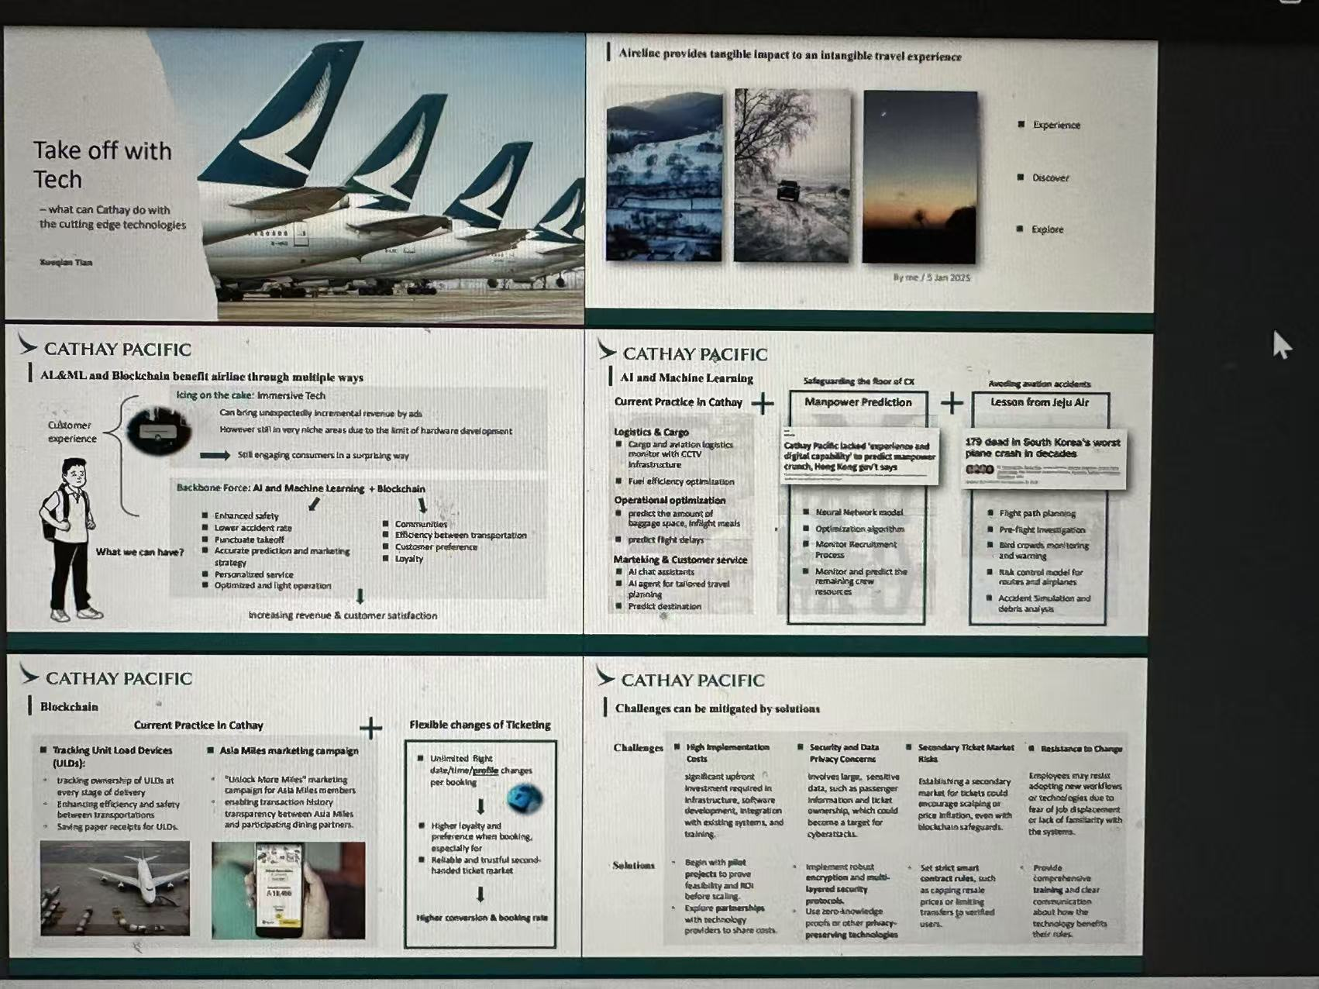
Sample pagestyle：
Q1: Could you please share more details about what do you do if the API limit is exceeded?
Q2: Have you test the APIs?
Q3: What specific problems do you encounter when you deploying your work to the server?
如果 Yahoo API 超出限制怎么办？你们是怎么处理的？
What happens if the Yahoo API limit is exceeded? How do you handle that?
A: 我们实现了降级策略：当 Yahoo API 返回 429 错误时，会自动回退到我们数据库中最近的收盘价进行展示和计算。
We implemented a fallback mechanism: if Yahoo API returns a 429 or 403 error, we automatically use the most recent closing price from our local database.
有做过接口测试吗？
Did you test the APIs?
A:
是的，我们使用 Postman 编写了测试集合来验证 API 的功能和响应状态码。
Yes, we used Postman to create collections and test the correctness of API functions and response codes.

Slide 3

Here‘s a story from our friend

Slide 4

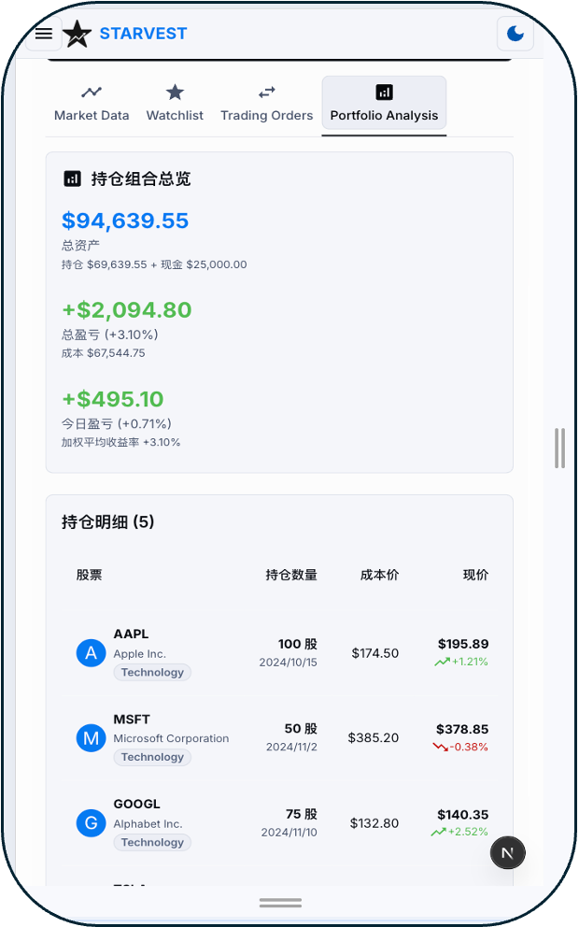
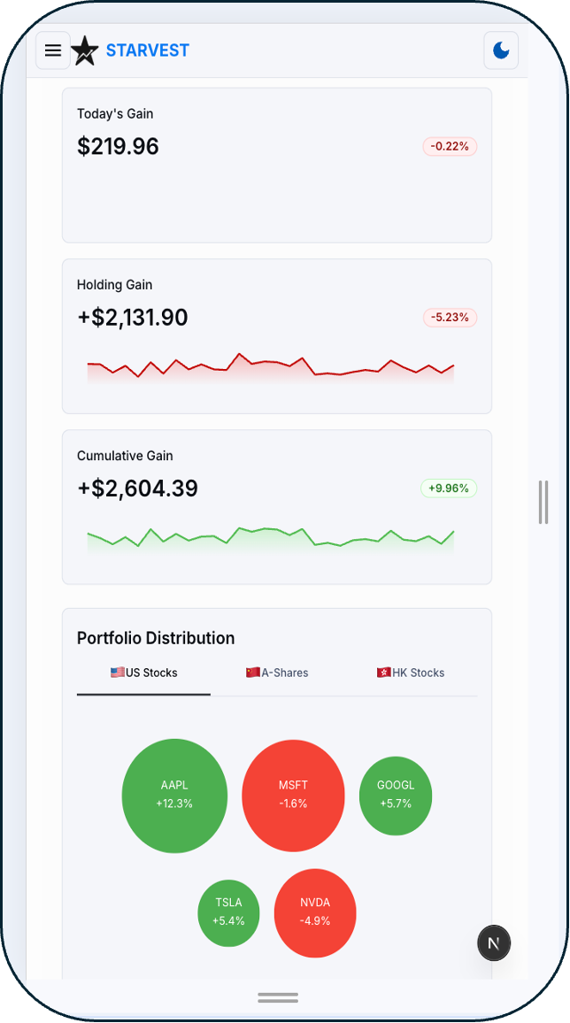
StarVest: Start from small in your investment journey
You can access the market, select your assets, and view performance
Main User
Scenarios
Investment rookie who just start to manage their portfolio
Scattered assets?
Blind performance tracking?
Fees buried?
Benefits
Radical
Transparency
Intelligence

Slide 5




How We Roll：Teamwork Matters
Project timeline
4 days, starts from 0 to 1
Mon Tue Wed Thu
Backend & Database Build Up
Phase 1
Basic version
Upgrade & Deploy to Server
Frontend layout & API connect
Phase 2
Upgrades
Frontend Polish & Slides
Phase 3

Slide 6
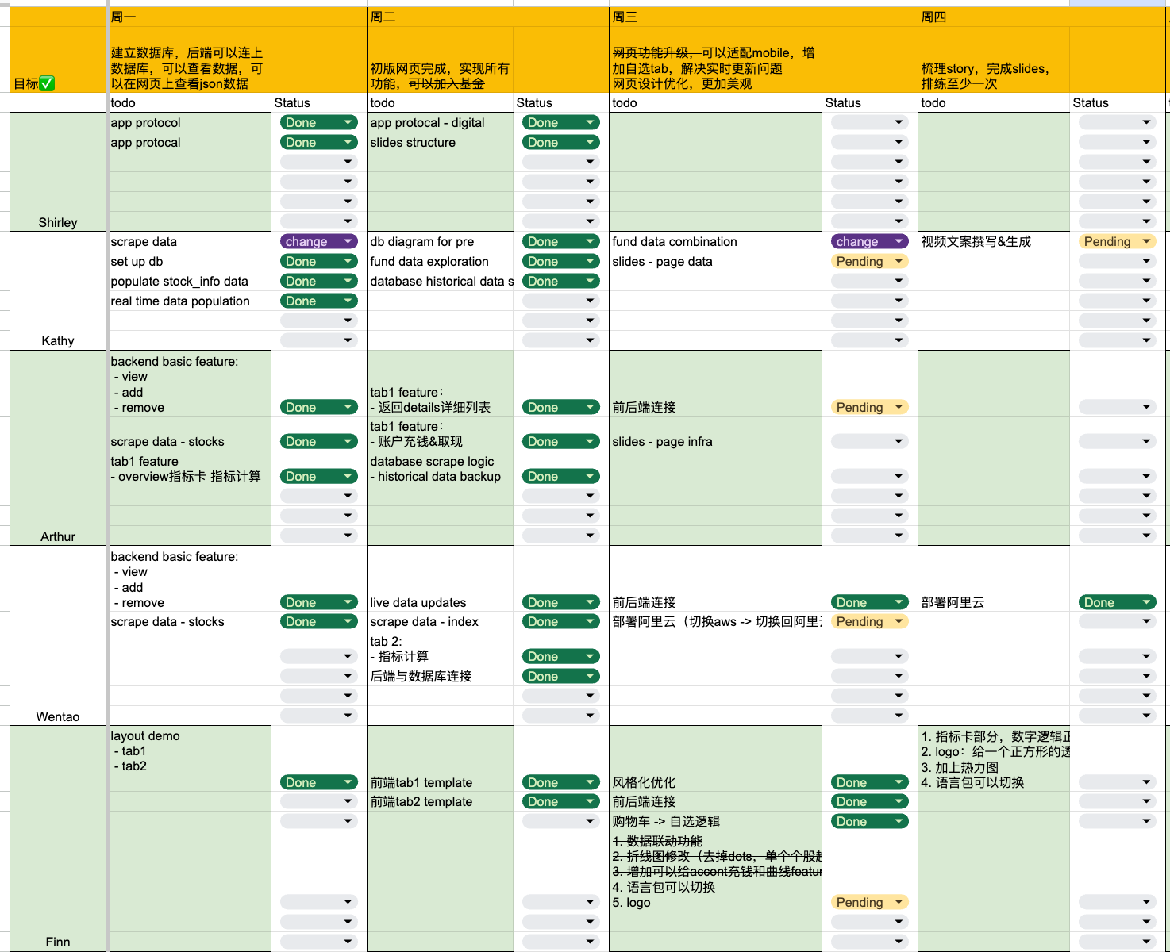


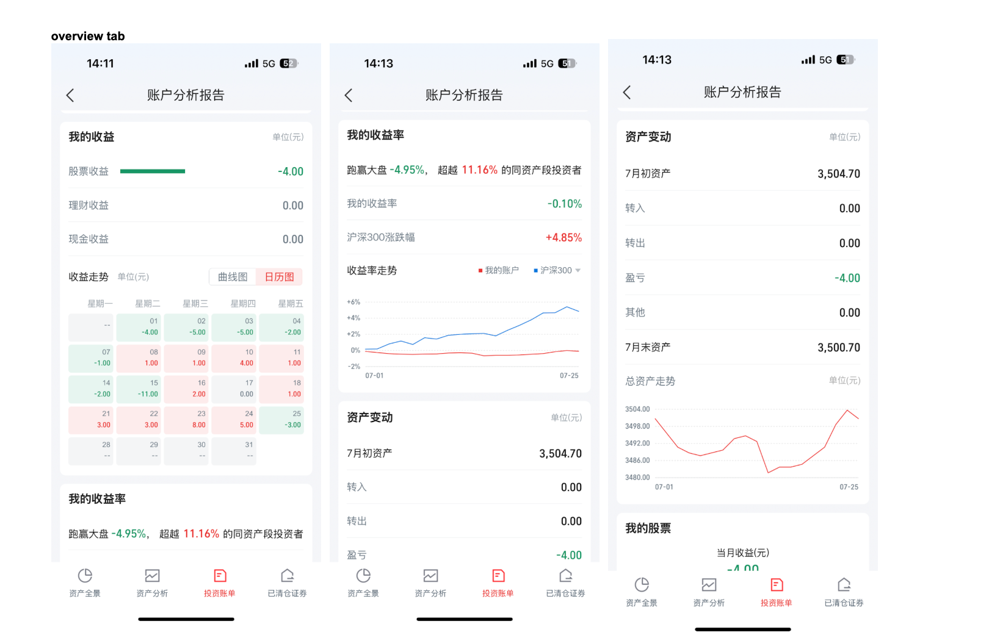
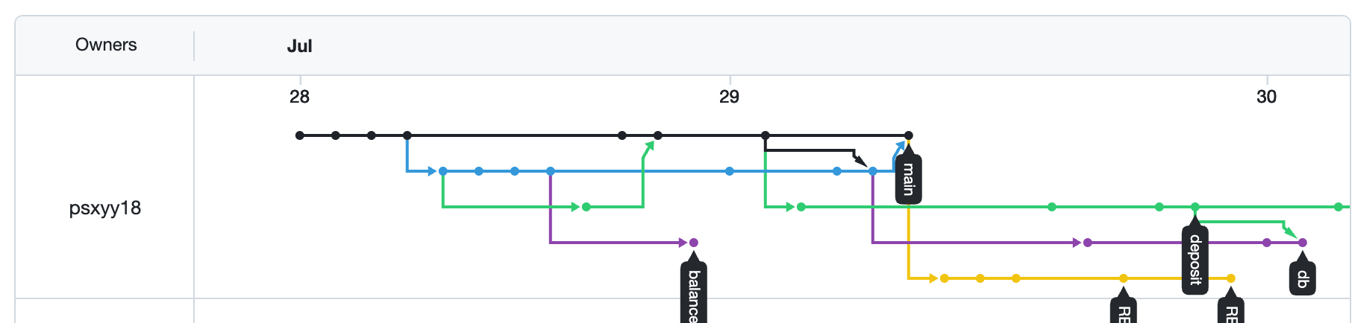
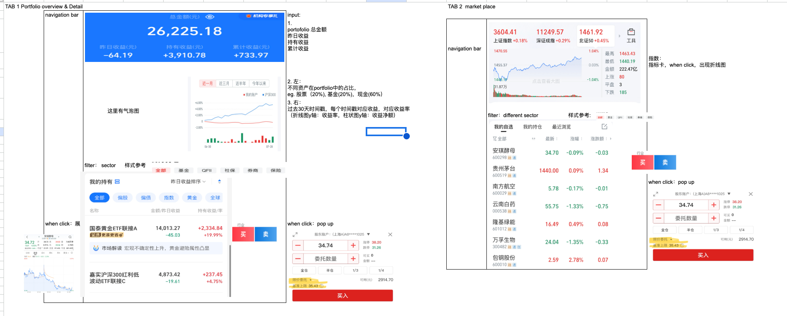
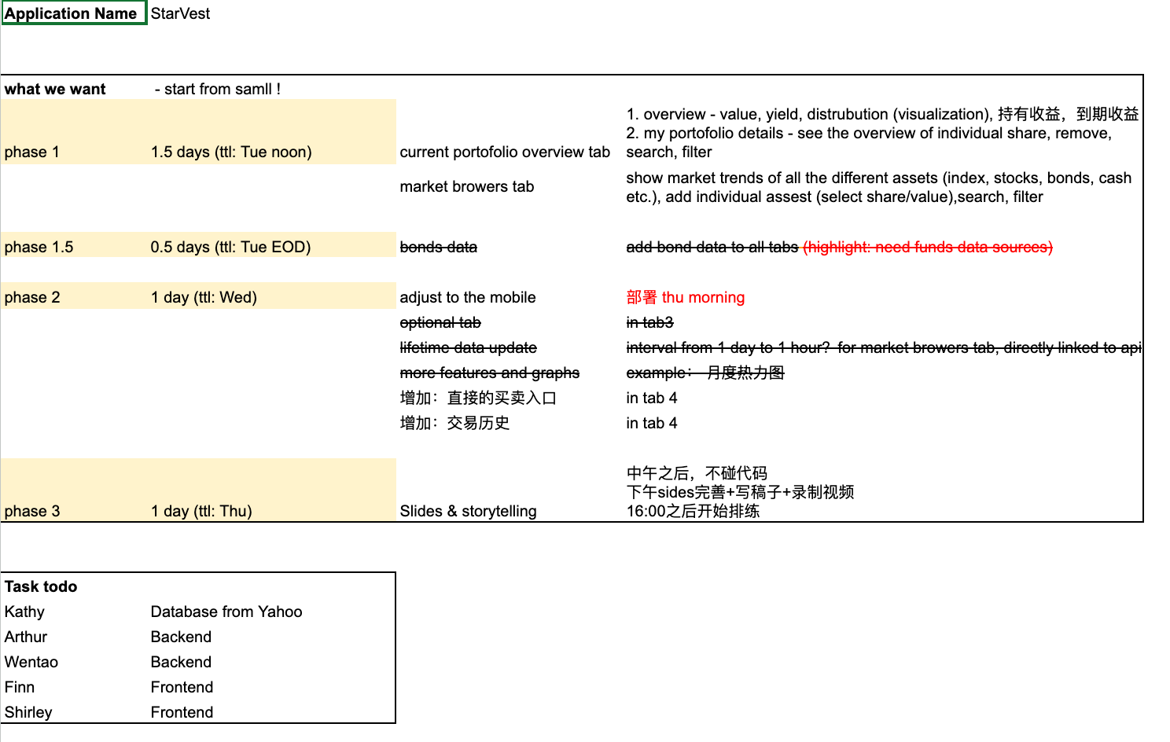
How We Roll：Teamwork Matters
Task Assignment
Pair programming and Agile Dev
Backend
Database
Frontend
Tracker
Google share doc & Git

Slide 7
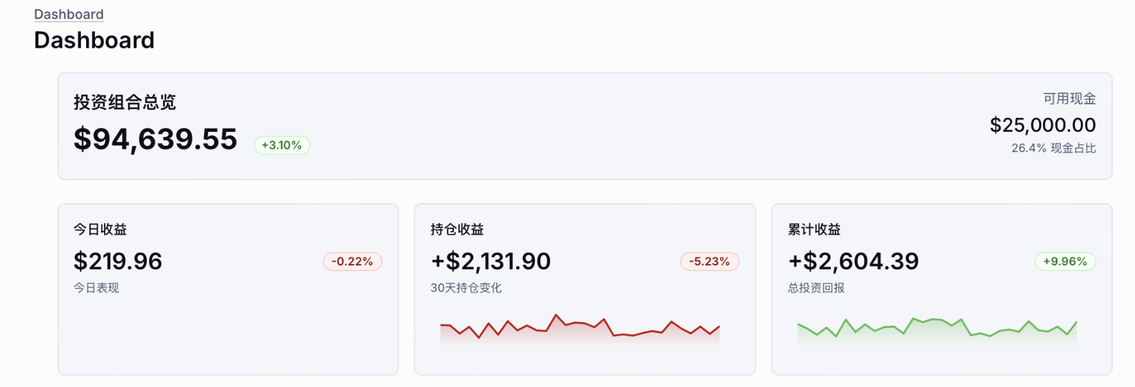
System Demo: Performance Overview
Tab1

Slide 8
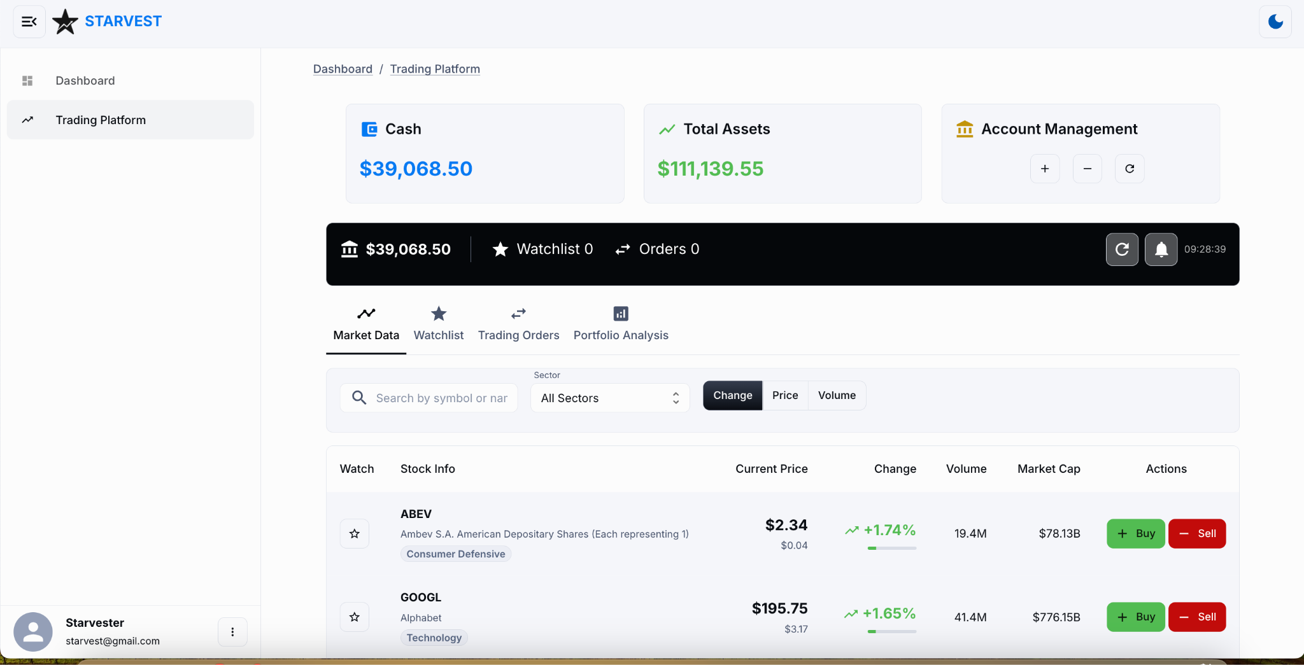
System Demo: Market Trends
Tab 2

Slide 9



Key Endpoints
Portfolio Management
Trading Operations
Market Data
Get portfolio & details
Portfolio summary and performance stats
Deposit / Withdraw cash
Buy and sell stocks
Remove holdings
Get real-time quotes (Yahoo Finance API + fallback from DB)
Historical stock data

Slide 10




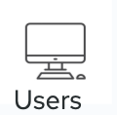
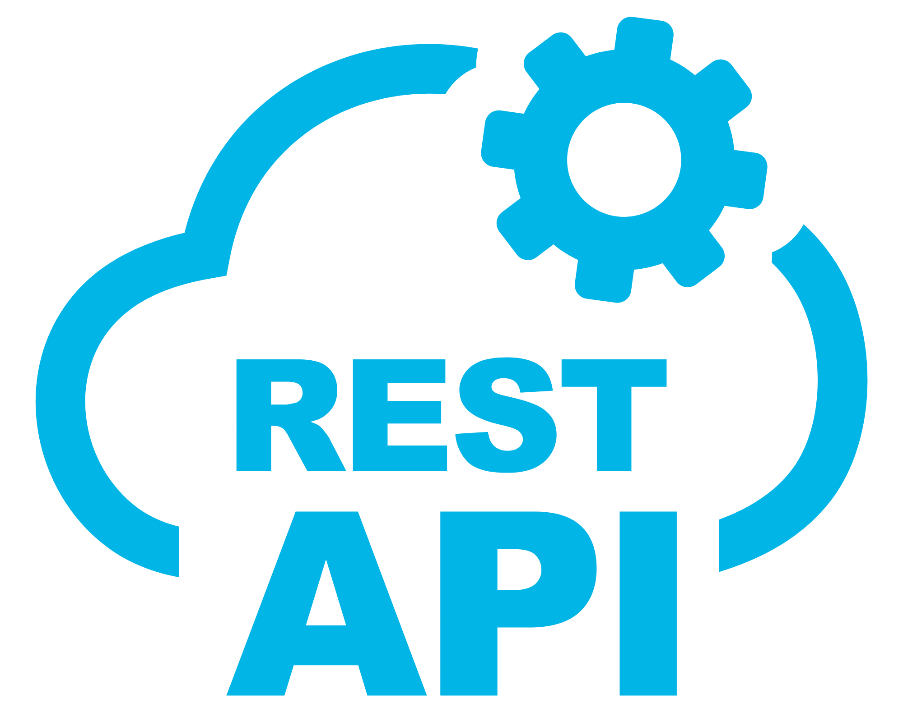
System Architecture and Tech Stack
Frontend
Next.js (REACT)
DataSource
Typescript
Database
Kaggle
MySQL
Backend
Yahoo Finance API
Express (Rest API)
JavaScript
Node.js

Slide 11
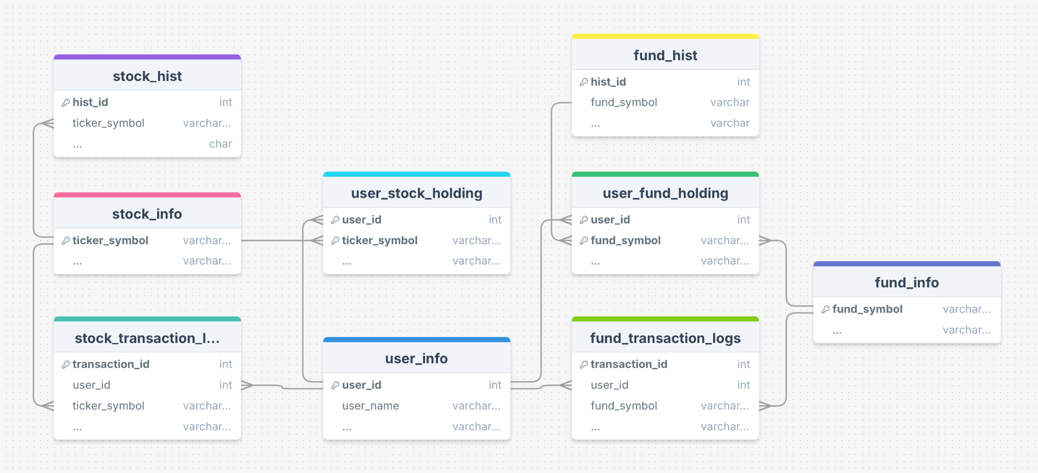
Data source & Data model
Data source
ERD of database
Metadata
Historical data
Transactional data

Slide 12

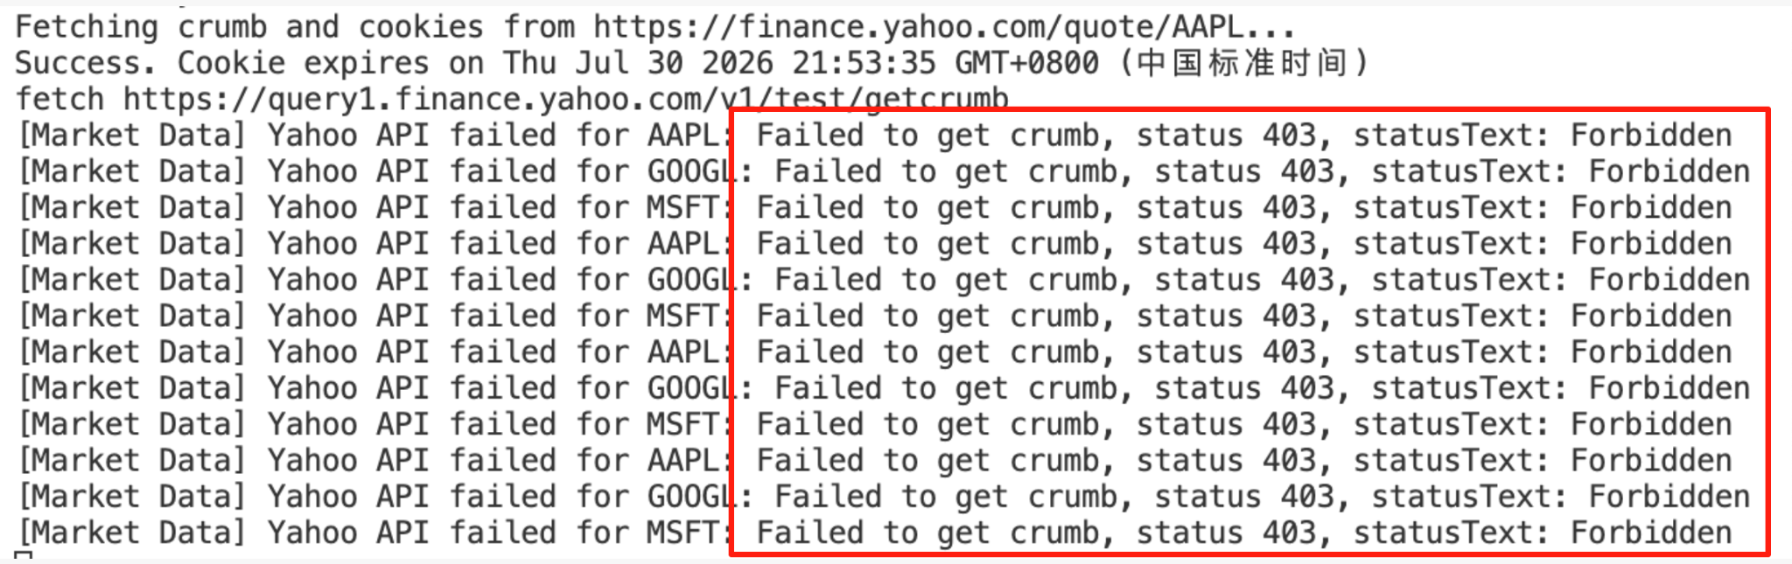

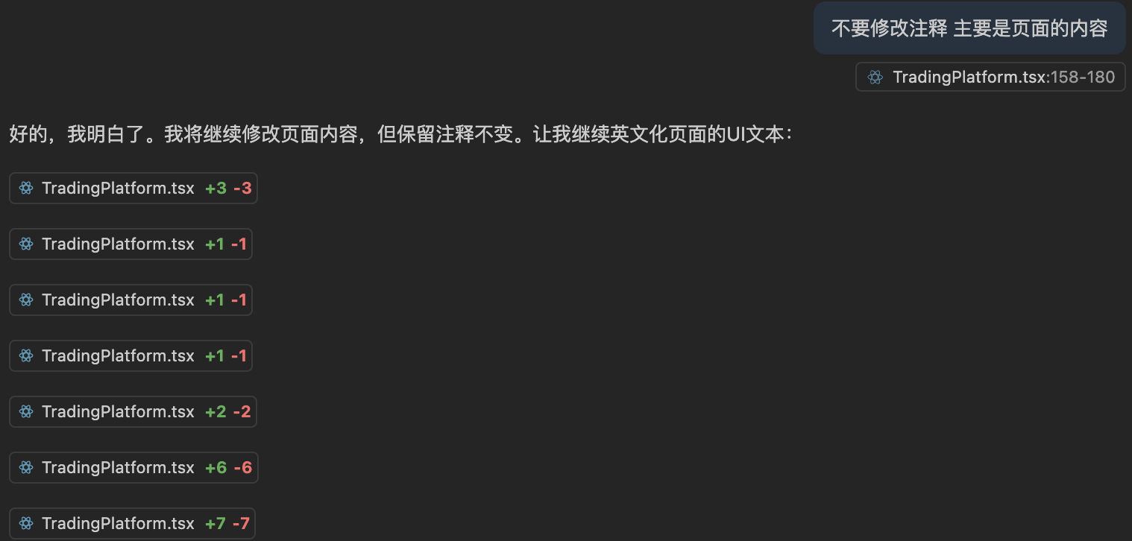
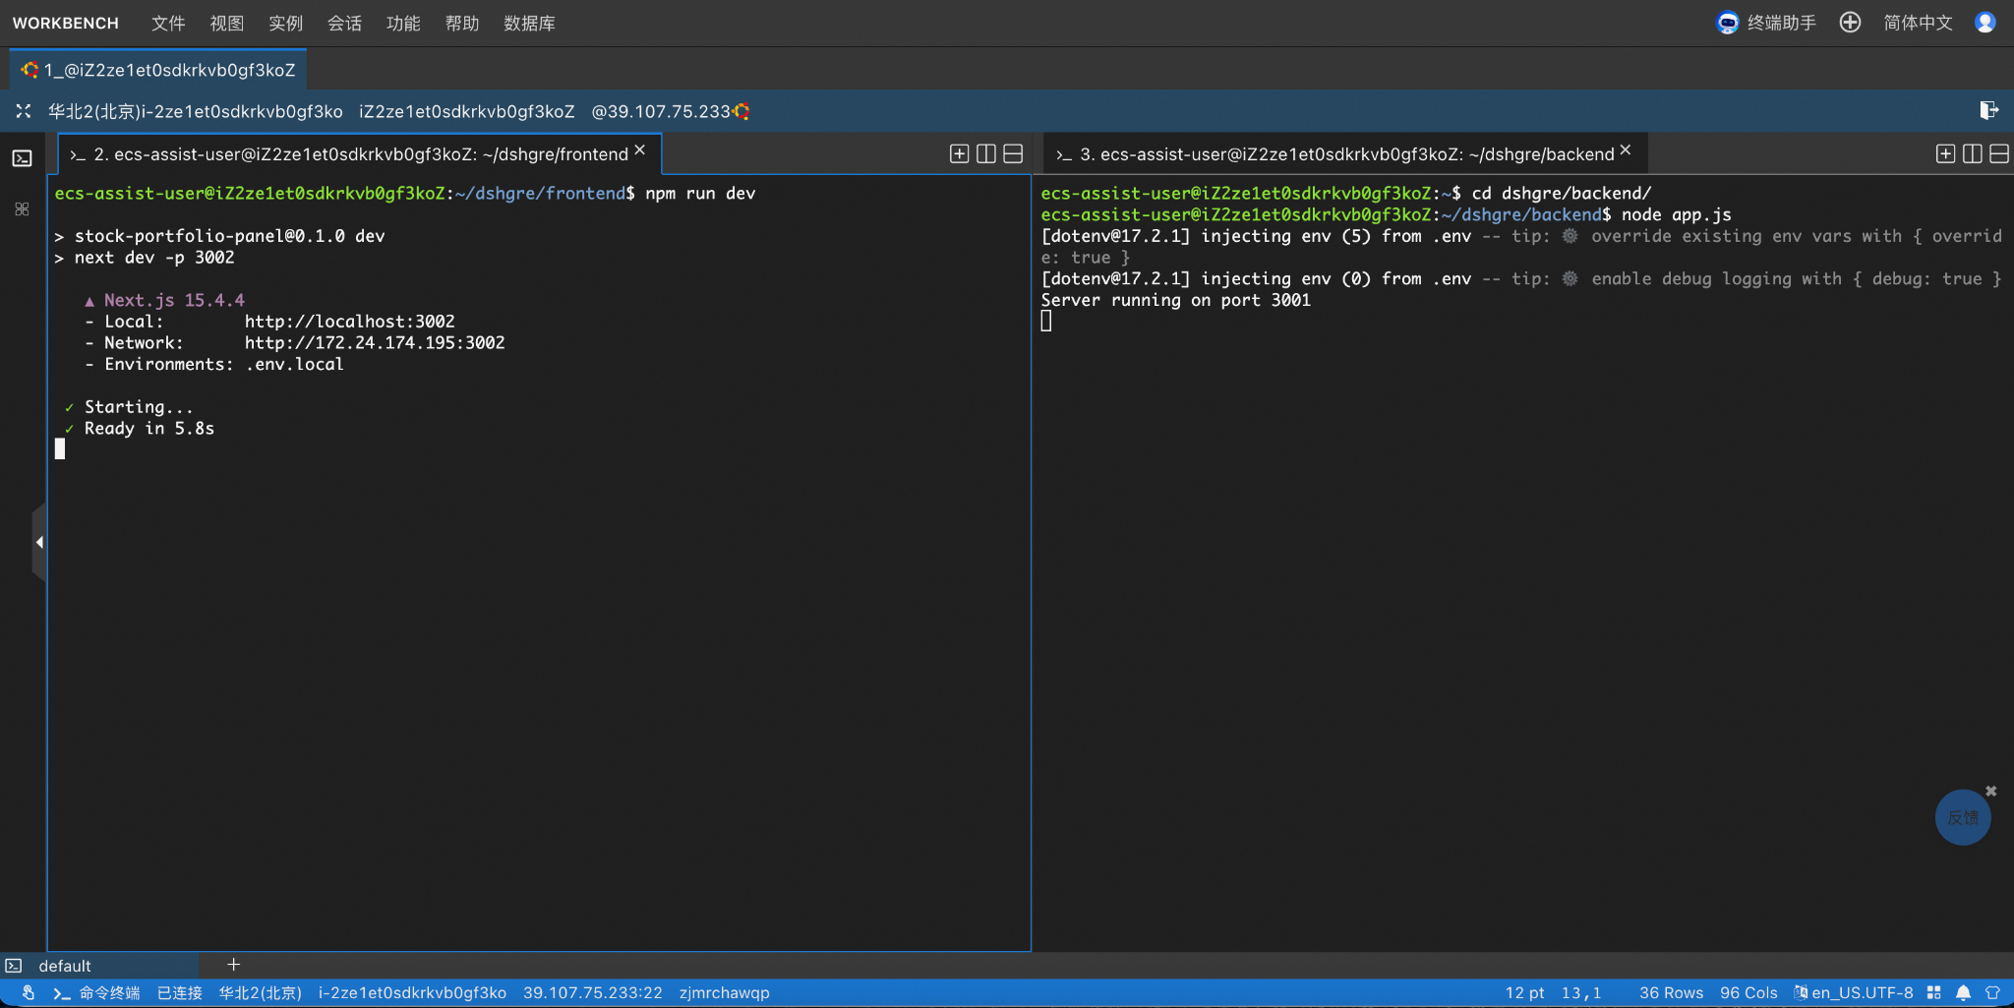
What we learn: External technical risks
Challenges
Solutions
Live time data accessibility
Plan B：Back up with historical data
Monitoring & Alerting
Blended Data Mode
AI Drift
Prompts engineering
Split tasks
Clarify requirements
Define input-output structure
Challenges
Different environment between frontend and backend before deploying to server
External threats 服务器性能太弱
AI 调试
Lessons Learned
Double plans（连不连前后端）（上不上server）
Clear cut time for

Slide 13

What we learn: Project Management
Challenges
SOP (Standard Operating Procedure)
Tight Schedule
Over-scoping
We want too much features!
Limited experience on Javascript
Always have parallel plans
Prioritize your tasks
Assign tasks wisely
Start Small, Scale Top

Slide 14

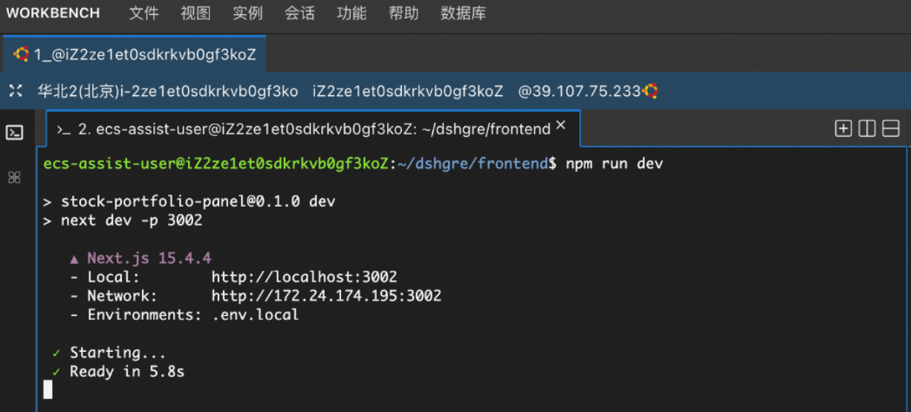
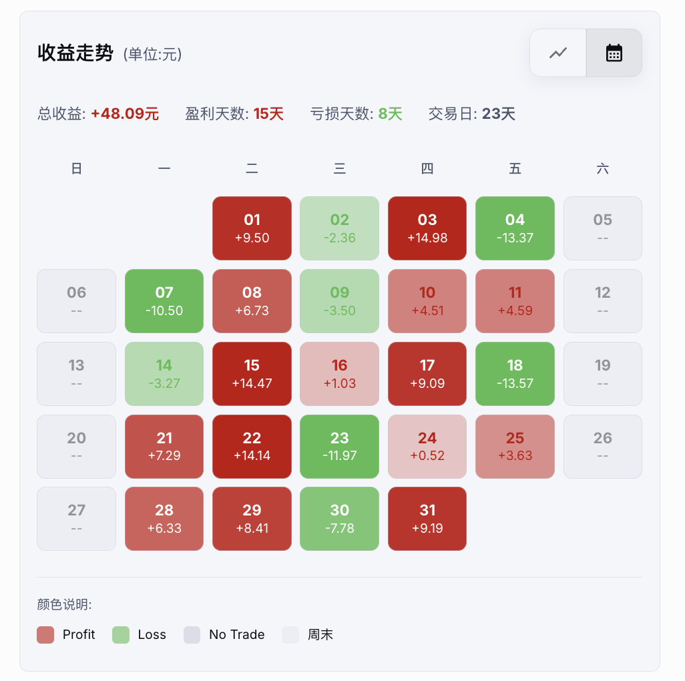
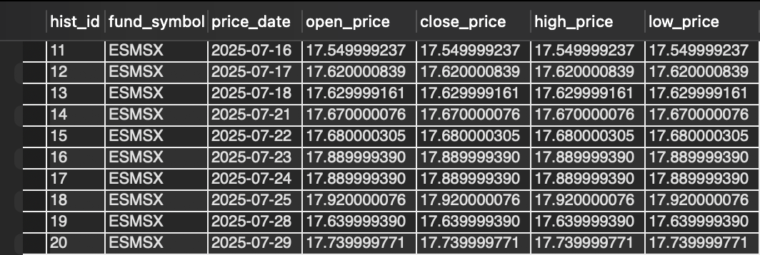
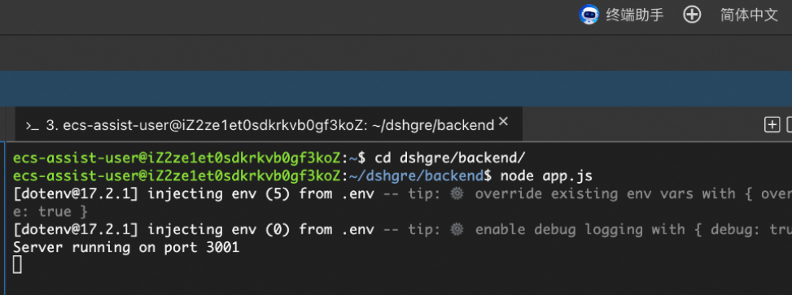
Future Steps: Advanced Features & Abundant data
Server Network
Abundant data
Advanced feature
Process: 60%
Blockpoint: external server stability and capacity
Process: 80%
Blockpoint: Funds data already inserted in database, need more time to combine into our frontend
Process: 50%
Blockpoint: Need more time to develop

Slide 15
Thanks for listening .

